Slide 1
MID-TERM Project review
Client team : Group 18
Developer Team : Group 14

Slide 2
Summary OF PROJECT
The project aims to develop a standalone Web app that enables effective shared grocery and expense management. The app automates inventory management and sends notifications when supplies run low, reducing the risk of running out of essential items. It also facilitates expense management by allowing users to split grocery bills and track expenses in real-time. The app further aims to reduce food waste and expenses through monthly usage analysis, providing users with insights into their consumption patterns and enabling them to make informed decisions about their shopping habits. Overall, the app offers a convenient and efficient solution to grocery and expense management for individuals and households.

Slide 3
MILESTONES ACHIEVED
PLANNING
USER STORIES AND INITIAL SETUP
Connected with the client team for the requirement analysis and project needs
Build ERD Diagram and user stories along with the project’s initial setup
USER MANAGEMENT
User’s login and registration

Slide 4
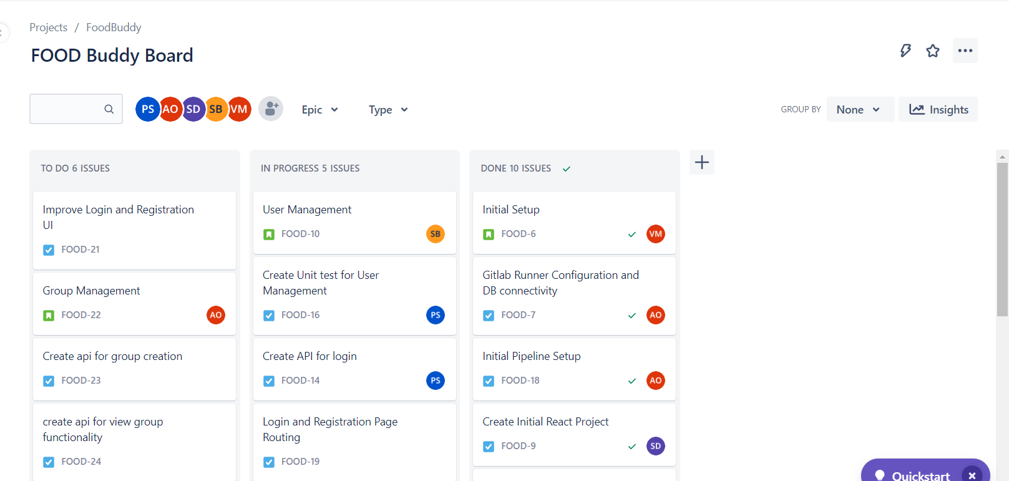
DASHBOARD (JIRA)

Slide 5
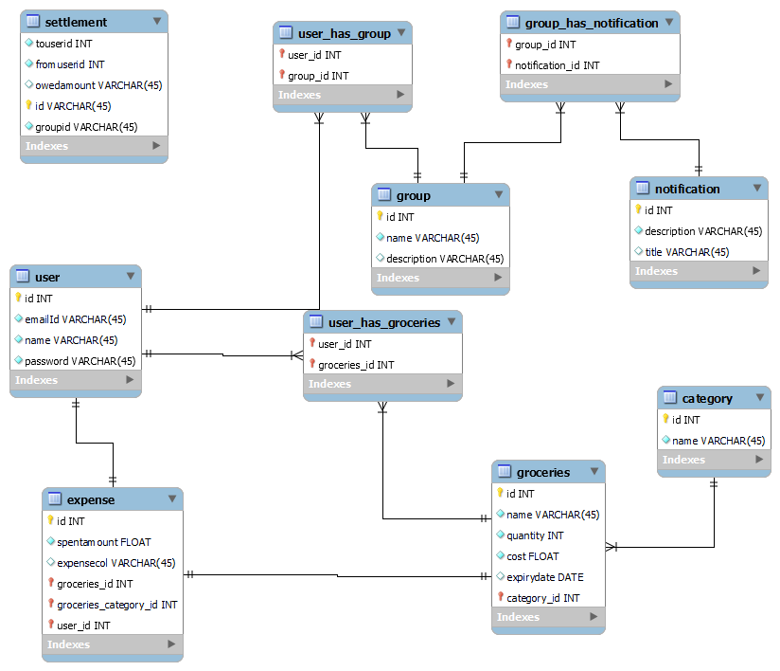
ERD

Slide 6
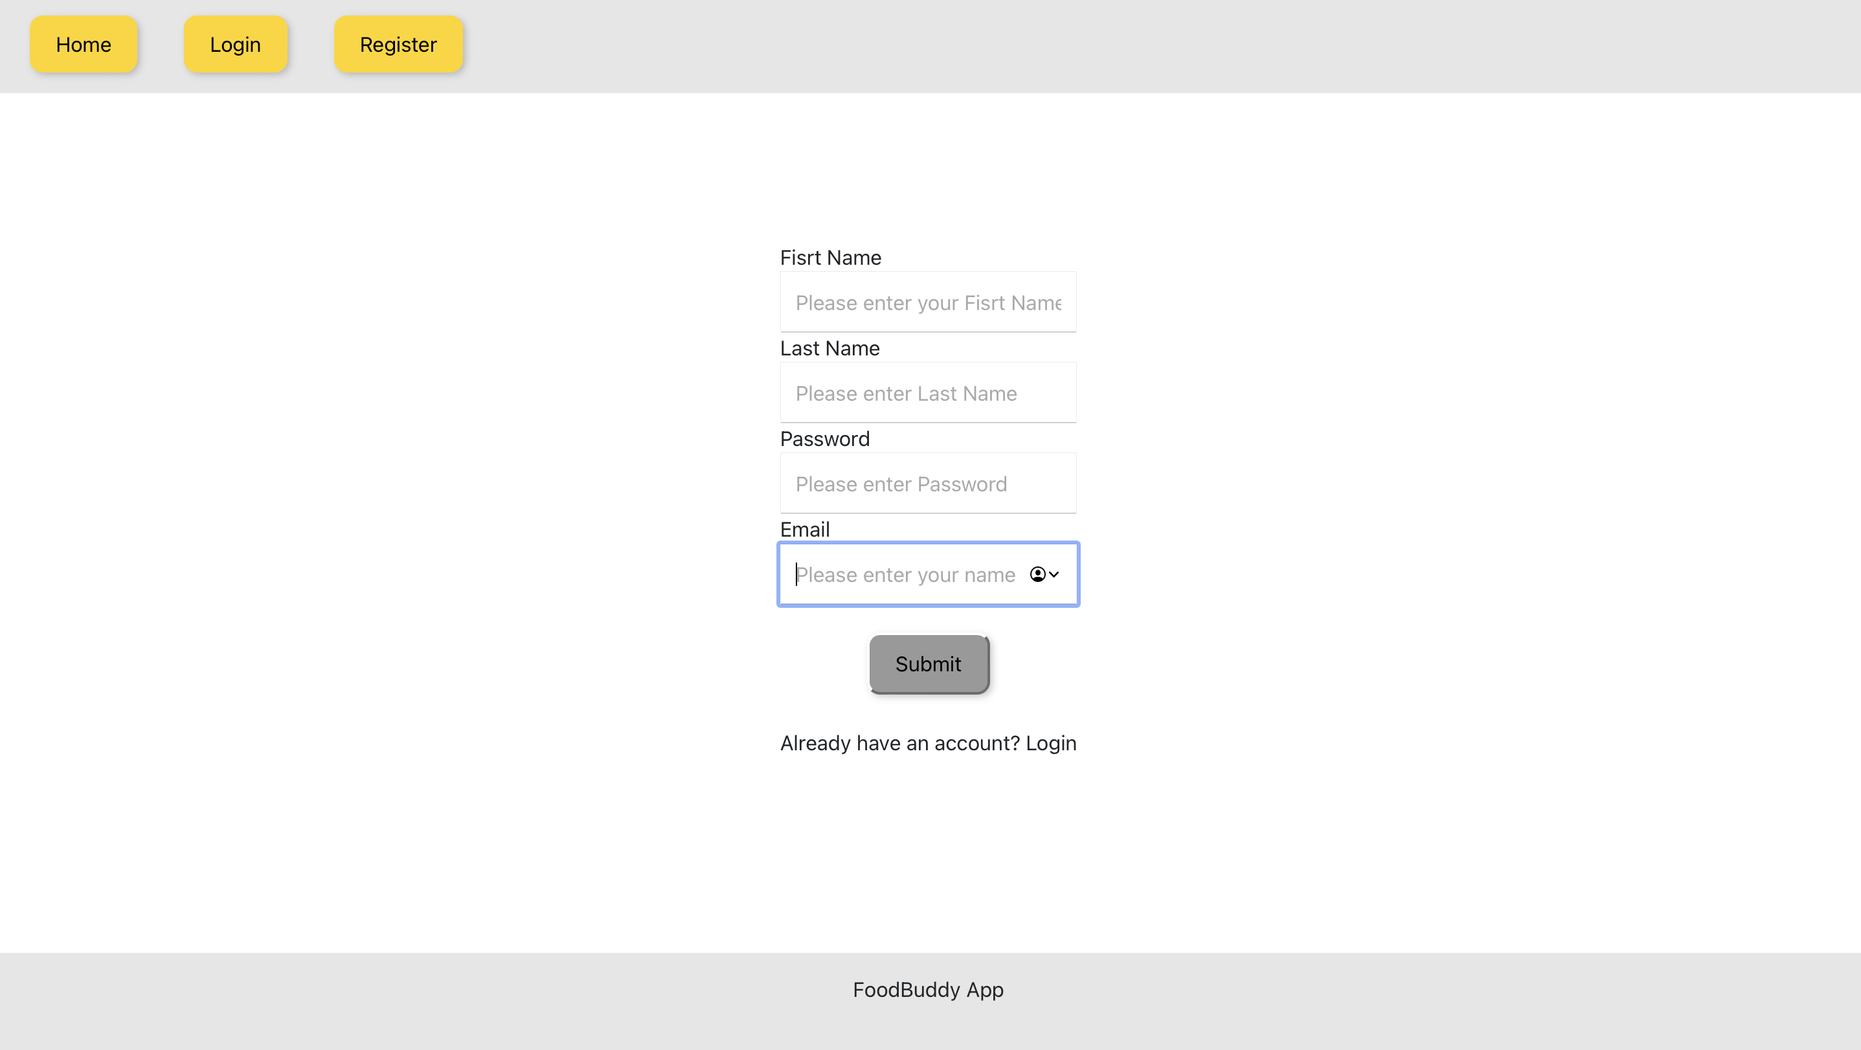
SCREENSHOTS

Slide 7
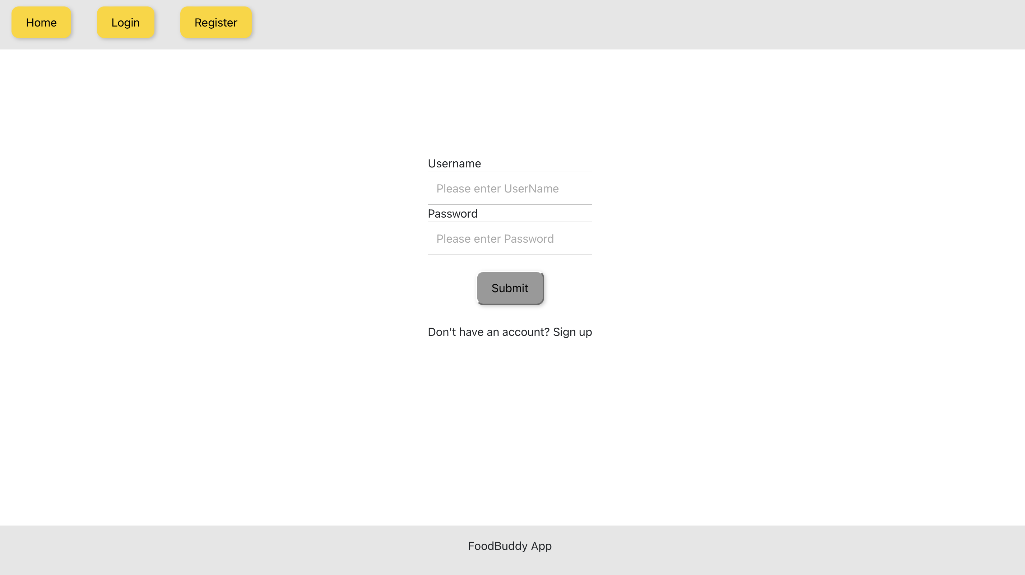
SCREENSHOTS

Slide 8
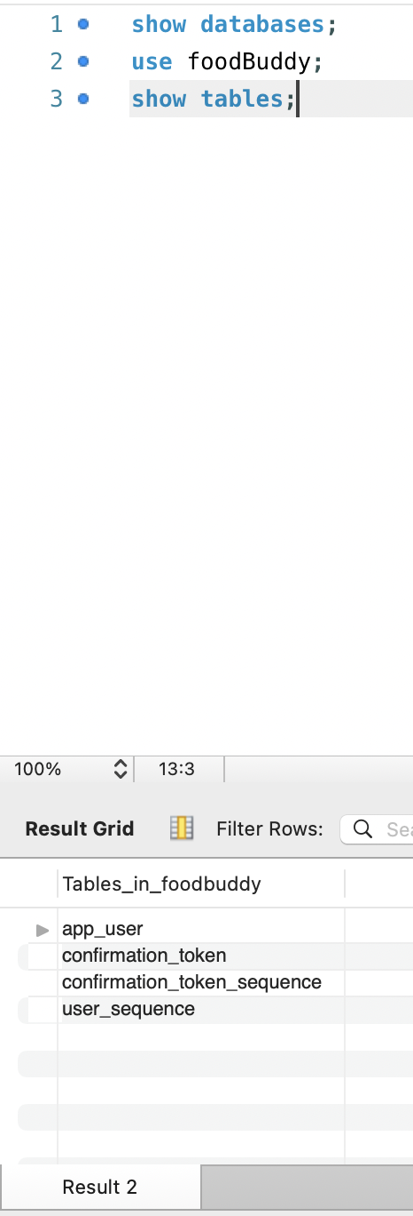
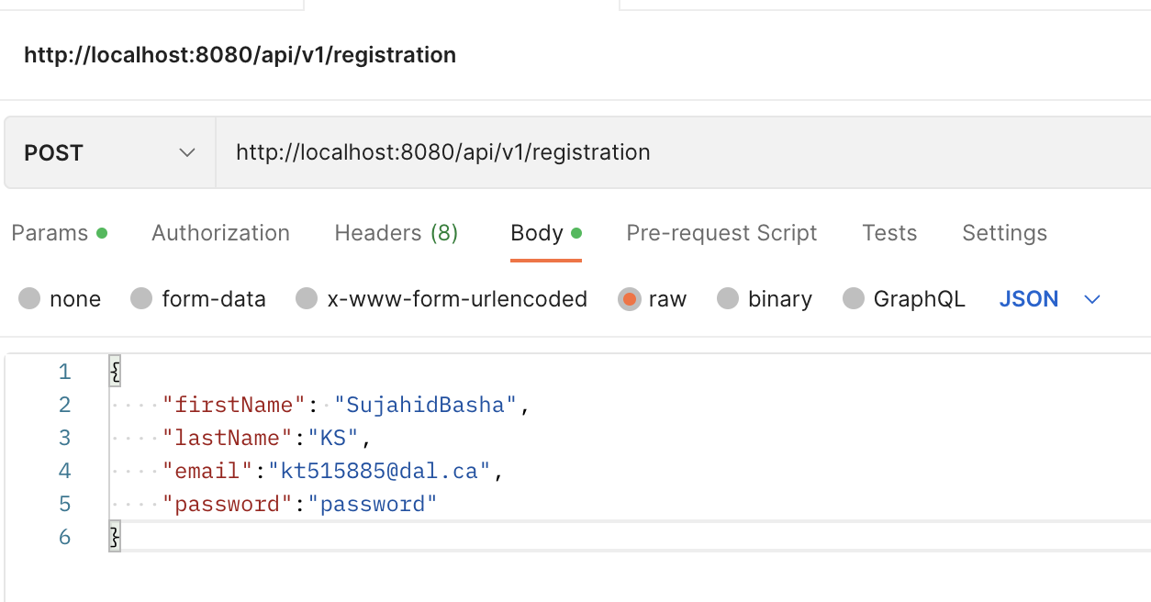
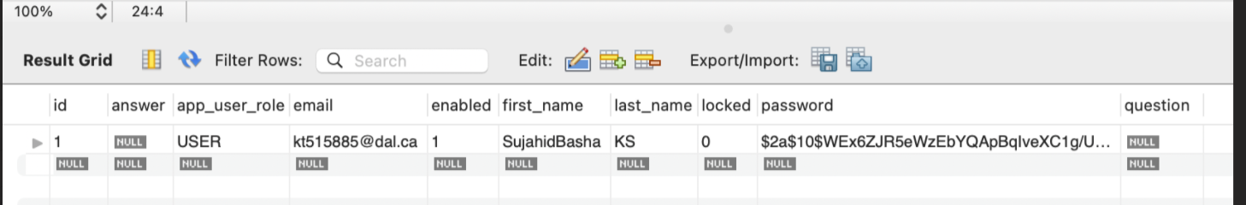
SCREENSHOTS

Slide 9
MEETING’S WITH CLIENT
4
5
7
With client team
With TA’s
Internal Meetings

Slide 10
TWO-MONTH ACTION PLAN
User Management
Grocery expense management
Gather feedback
2023
JAN
FEB
MAR
APR
MAY
JUN
JUL
AUG
SEP
OCT
NOV
DEC
2023
JAN
FEB
MAR
APR
MAY
JUN
JUL
AUG
SEP
OCT
NOV
DEC
Group Management
Testing & Deployment
Delivery

Slide 11
CHALLENGES
1) A large and comprehensive dataset is needed for better recommendations of recipes.

Slide 12
THANK YOU

